Slide 1
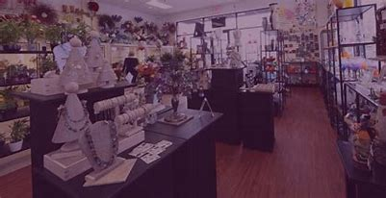
local craft Designing market area

Slide 2
Introduction:
A local artisan market is important for bringing the community together, encouraging creativity, and boosting the local economy. It gives artists, craftspeople, and small business owners a chance to display and sell their handmade products. These markets help artisans connect directly with customers, creating personal bonds and increasing appreciation for unique, handmade items.

Slide 3
Survey of Existing Websites:
Handmade at Amazon:
Crated Marketplace: Only for authentic handmade products.
Global Reach: Access to Amazon’s large customer base.
Prime Eligibility: Faster shipping through FBA services.
Customization: Options for personalized products.
Secure Payments: Reliable Amazon payment system.
No Listing Fees: 15% referral fee per sale.
Vetting Process: Ensures authenticity of artisans.
Sales Tools: Analytics and marketing opportunities.

Slide 4
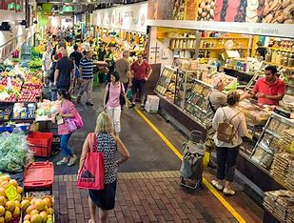
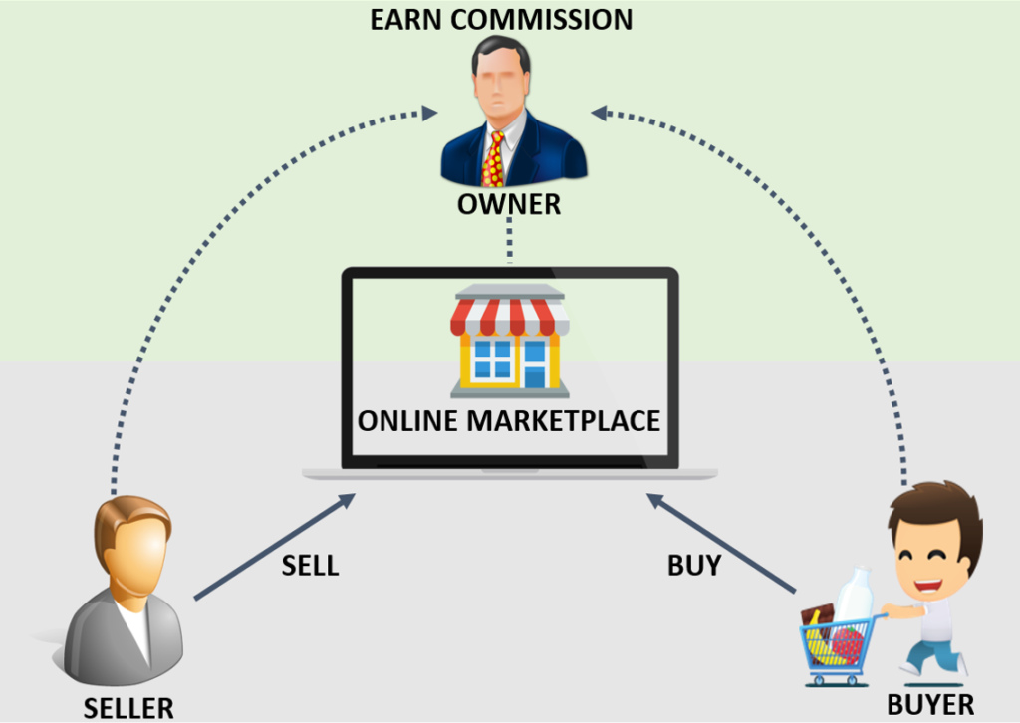
Local market place
Online market place

Slide 5
India Bazaar:
India Bazaar typically refers to vibrant markets or events showcasing Indian culture, crafts, and traditional products. These bazaars represent the essence of India’s rich cultural heritage, offering everything from textiles, jewelry, and home décor to spices, food, and handmade crafts.
Key Elements of an India Bazaar:
Handicrafts: Intricately crafted items like pottery, woodwork, metalwork, and embroidered fabrics.
Textiles: Traditional sarees, dupattas, and regional handwoven fabrics like Banarasi.
Jewelry: Exquisite gold, silver, and imitation jewelry reflecting Indian artistry.
Spices and Food: Authentic spices, herbs, snacks, sweets, and teas from different regions of India.
Festive Vibes: Many India Bazaars are held during festivals with music, dance, and cultural activities.

Slide 6
Technology Stack :
Frontend: React (Web) / React Native (Mobile)
Backend: Node.js/Django, Microservices
Database: MySQL/PostgreSQL, MongoDB
Hosting: AWS/Google Cloud
Security: SSL/TLS, JWT
Admin: Dashboard for management
Payment: Stripe/ Razor pay

Slide 7
Design an Architecture:
Components:
Product Management – Sellers list and manage products.
Search & Filters – Product search with filters.
Shopping Cart & Checkout – Cart management and secure payment.
Order Management – Track orders and shipping.
Payment Gateway – Integration with Stripe/ Razorpay.
Reviews & Ratings – Buyer feedback on products.
Admin Dashboard – Manage users, products, and orders.
Notifications – Real-time alerts.
Security – SSL/TLS encryption and role-based access.

Slide 8
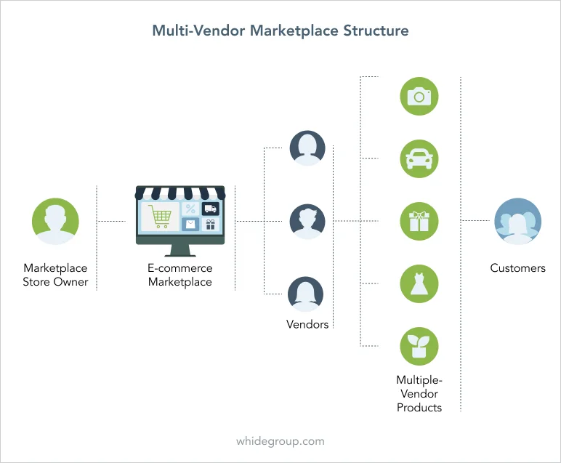

Slide 9
Features and Functionalities:
User features:
Account Creation & Login
Register via email or social media (Google/Facebook).
Secure login/logout functionality.
Profile Management
Users can update personal details (name, address, payment info).
Manage preferences and notifications.
Product Search & Browsing
Search products by category, price, rating, and location.
Browse detailed product listings with images, descriptions, and reviews.
Cart Management
Add, update, or remove items from the shopping cart.
View total price and apply discounts (if available).
Order Placement & Checkout
Secure checkout process with multiple payment options (credit/debit cards, wallets).
Option to add shipping address and track the order status.

Slide 10
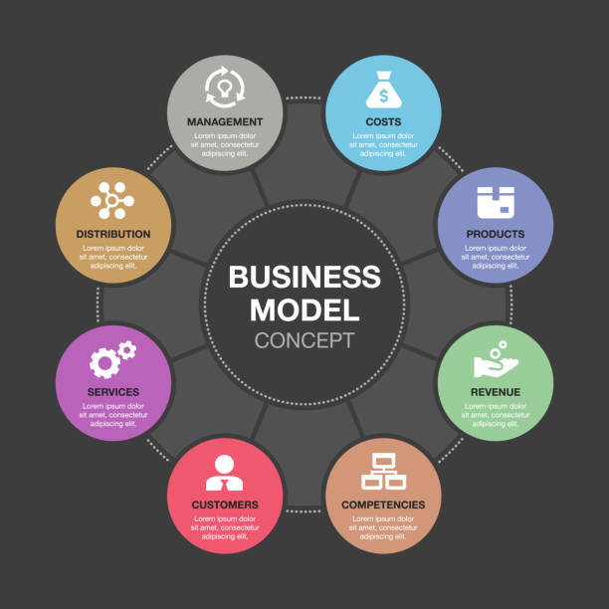

Slide 11
Development Workflow:
Planning & Design : Define features, gather requirements, and design UI/UX (wireframes).
Security : Implement SSL/TLS, JWT authentication, and secure payment integration (Stripe, Razor pay ).
Payment Integration : Integrate payment gateways for transactions.
Testing: Perform unit, integration, and UI testing across platforms.
Deployment : Deploy on cloud services (AWS, Google Cloud), test, and release to production.
Maintenance : Monitor, fix bugs, and add new features based on user feedback.

Slide 12
ROLES:
Hemanth : Project Manager
Hemanth : Tester/Debugger
Hemanth : Frontend
Hemanth : Backend
Hemanth : Database

